Slide 1
Switching Techniques

Slide 2
Switching Terms
Switching Nodes:
Intermediate switching device that moves data
Not concerned with content of data
Stations:
End devices that wish to communicate
Each station is connected to a switching node
Communications Network:
A collection of switching nodes

Slide 3
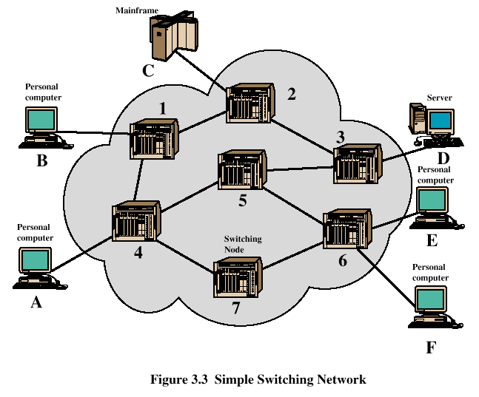
Switched Network

Slide 4
Observations of Figure 3.3
Some nodes connect only to other nodes (e.g., 5 and 7)
Some nodes connect to one or more stations
Node-station links usually dedicated point-to-point links
Node-node links usually multiplexed links
Frequency-division multiplexing (FDM)
Time-division multiplexing (TDM)
Not a direct link between every node pair

Slide 5
Techniques Used in Switched Networks
Circuit switching
Dedicated communications path between two stations
E.g., public telephone network
Packet switching
Message is broken into a series of packets
Each node determines next leg of transmission for each packet

Slide 6
Phases of Circuit Switching
Circuit establishment
An end to end circuit is established through switching nodes
Information Transfer
Information transmitted through the network
Data may be analog voice, digitized voice, or binary data
Circuit disconnect
Circuit is terminated
Each node deallocates dedicated resources

Slide 7
Components of Public Telecommunications Network
Subscribers - devices that attach to the network; mostly telephones
Subscriber line - link between subscriber and network
Also called subscriber loop or local loop
Exchanges - switching centers in the network
A switching centers that support subscribers is an end office
Trunks - branches between exchanges

Slide 8
Characteristics of Circuit Switching
Can be inefficient
Channel capacity dedicated for duration of connection
Utilization not 100%
Delay prior to signal transfer for establishment
Once established, network is transparent to users
Information transmitted at fixed data rate with only propagation delay

Slide 9
How Packet Switching Works
Data is transmitted in blocks, called packets
Before sending, the message is broken into a series of packets
Typical packet length is 1000 octets (bytes)
Packets consists of a portion of data plus a packet header that includes control information
At each node en route, packet is received, stored briefly and passed to the next node

Slide 10
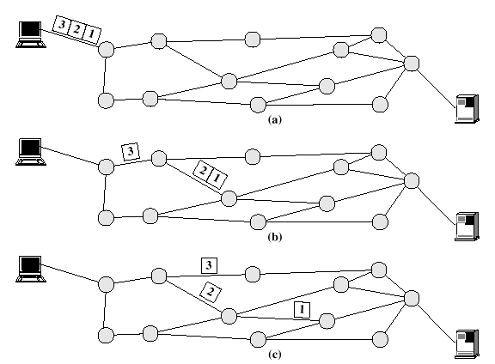
Packet Switching

Slide 11
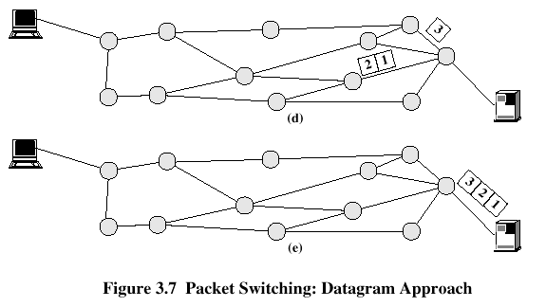
Packet Switching

Slide 12
Packet Switching Advantages
Line efficiency is greater
Many packets over time can dynamically share the same node to node link
Packet-switching networks can carry out data-rate conversion
Two stations with different data rates can exchange information
Unlike circuit-switching networks that block calls when traffic is heavy, packet-switching still accepts packets, but with increased delivery delay
Priorities can be used

Slide 13
Disadvantages of Packet Switching
Each packet switching node introduces a delay
Overall packet delay can vary substantially
This is referred to as jitter
Caused by differing packet sizes, routes taken and varying delay in the switches
Each packet requires overhead information
Includes destination and sequencing information
Reduces communication capacity
More processing required at each node

Slide 14
Packet Switching Networks - Datagram
Each packet treated independently, without reference to previous packets
Each node chooses next node on packet’s path
Packets don’t necessarily follow same route and may arrive out of sequence
Exit node restores packets to original order
Responsibility of exit node or destination to detect loss of packet and how to recover

Slide 15
Packet Switching Networks – Datagram
Advantages:
Call setup phase is avoided
Because it’s more primitive, it’s more flexible
Datagram delivery is more reliable

Slide 16
Packet Switching Networks – Virtual Circuit
Preplanned route established before packets sent
All packets between source and destination follow this route
Routing decision not required by nodes for each packet
Emulates a circuit in a circuit switching network but is not a dedicated path
Packets still buffered at each node and queued for output over a line

Slide 17
Packet Switching Networks – Virtual Circuit
Advantages:
Packets arrive in original order
Packets arrive correctly
Packets transmitted more rapidly without routing decisions made at each node

Slide 18
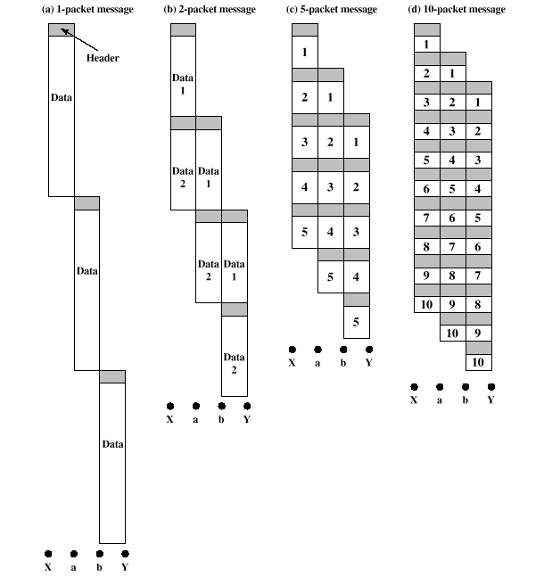
Effect of Packet Size on Transmission

Slide 19
Effect of Packet Size on Transmission
Breaking up packets decreases transmission time because transmission is allowed to overlap
Figure 3.9a
Entire message (40 octets) + header information (3 octets) sent at once
Transmission time: 129 octet-times
Figure 3.9b
Message broken into 2 packets (20 octets) + header (3 octets)
Transmission time: 92 octet-times

Slide 20
Effect of Packet Size on Transmission
Figure 3.9c
Message broken into 5 packets (8 octets) + header (3 octets)
Transmission time: 77 octet-times
Figure 3.9d
Making the packets too small, transmission time starts increases
Each packet requires a fixed header; the more packets, the more headers

Slide 21
Asynchronous Transfer Mode (ATM)
Also known as cell relay
Operates at high data rates
Resembles packet switching
Involves transfer of data in discrete chunks, like packet switching
Allows multiple logical connections to be multiplexed over a single physical interface
Minimal error and flow control capabilities reduces overhead processing and size
Fixed-size cells simplify processing at ATM nodes

Slide 22
ATM Terminology
Virtual channel connection (VCC)
Logical connection in ATM
Basic unit of switching in ATM network
Analogous to a virtual circuit in packet switching networks
Exchanges variable-rate, full-duplex flow of fixed-size cells
Virtual path connection (VPC)
Bundle of VCCs that have the same end points

Slide 23
Advantages of Virtual Paths
Simplified network architecture
Increased network performance and reliability
Reduced processing and short connection setup time
Enhanced network services

Slide 24
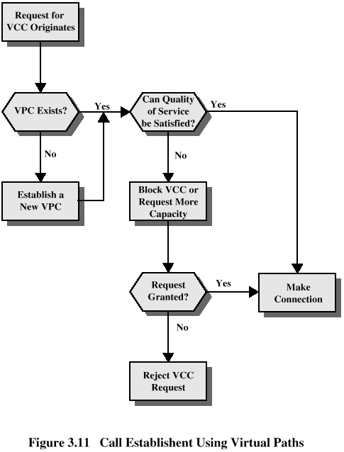
Call Establishment

Slide 25
Virtual Channel Connection Uses
Between end users
Can carry end-to-end user data or control signaling between two users
Between an end user and a network entity
Used for user-to-network control signaling
Between two network entities
Used for network traffic management and routing functions

Slide 26
Virtual Path/Virtual Channel Characteristics
Quality of service
Specified by parameters such as cell loss ratio and cell delay variation
Switched and semipermanent virtual channel connections
Cell sequence integrity
Traffic parameter negotiation and usage monitoring
Virtual channel identifier restriction within a VPC

Slide 27
ATM Cell Header Format
Generic flow control (GFC) – 4 bits, used only in user-network interface
Used to alleviate short-term overload conditions in network
Virtual path identifier (VPI) – 8 bits at the user-network interface, 12 bits at network-network interface
Routing field
Virtual channel identifier (VCI) – 8 bits
Used for routing to and from end user

Slide 28
ATM Cell Header Format
Payload type (PT) – 3 bits
Indicates type of information in information field
Cell loss priority (CLP) – 1 bit
Provides guidance to network in the event of congestion
Header error control (HEC) – 8 bit
Error code

Slide 29
ATM Service Categories
Real-time service
Constant bit rate (CBR)
Real-time variable bit rate (rt-VBR)
Non-real-time service
Non-real-time variable bit rate (nrt-VBR)
Available bit rate (ABR)
Unspecified bit rate (UBR)

Slide 30
Examples of CBR Applications
Videoconferencing
Interactive audio (e.g., telephony)
Audio/video distribution (e.g., television, distance learning, pay-per-view)
Audio/video retrieval (e.g., video-on-demand, audio library)

Slide 31
Examples of UBR applications
Text/data/image transfer, messaging, distribution, retrieval
Remote terminal (e.g., telecommuting)

